Slide 1
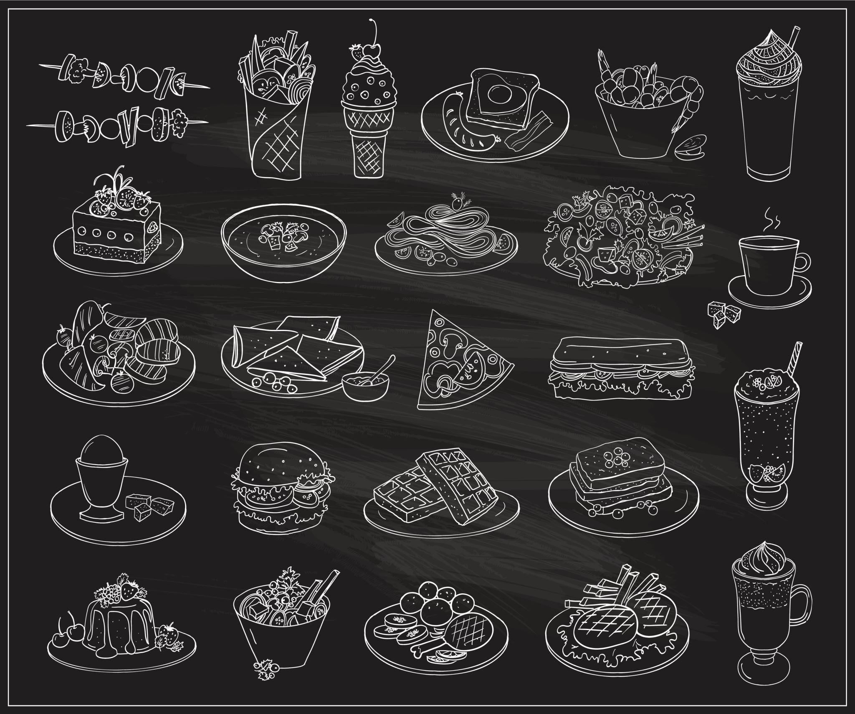
Online Food Ordering System

Slide 2

PROJECT TEAM
MEHMET TAHA APAK Project manager #Chapter1
CEM ERDOĞDU System Analyst #Chapter2
BERKAY ASLAN Developer #Chapter3
BURAK KAYA Busıness analyst #Chapter 4

Slide 3
The Project Definition:
The Online Food Ordering System is a comprehensive platform that aims to revolutionize the way customers order food or drinks for delivery or pickup. With an interactive and up-to-date menu, dynamic pricing based on selected options, and real-time updates for restaurants, the system provides a seamless and efficient experience for all parties involved.
One of the key business processes of the Online Food Ordering System is the order placement process. Customers can easily browse the menu, select items, and place their orders through the system’s app. The system calculates the total cost of the order based on the selected items and any applicable discounts or promotions, and allows the customer to enter their payment information and place the order. Once the order is placed, the system sends a notification to the restaurant to begin preparing the food. The restaurant can view the order details, including the items and any special instructions, in real-time through the system. This allows the restaurant to efficiently prepare and fulfill the order.

Slide 4
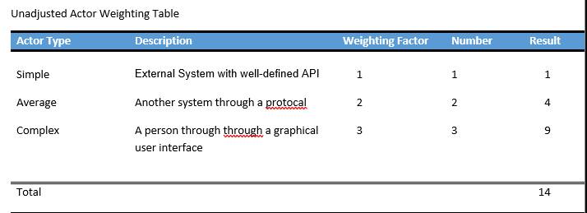
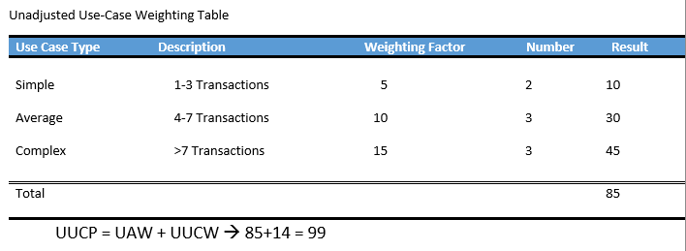
Use-case Estimation:

Slide 5
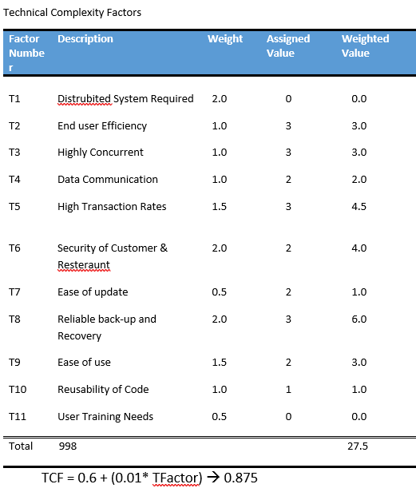
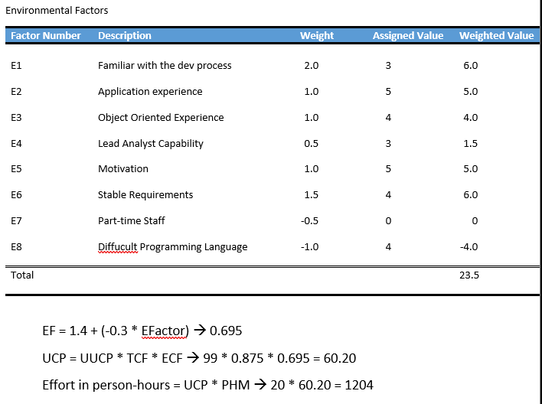

Slide 6
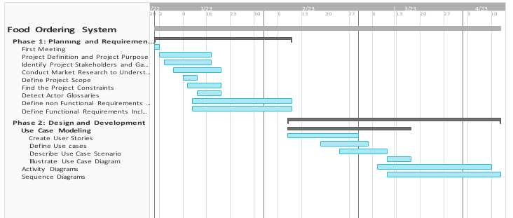
Gantt Chart

Slide 7

The Project Purpose:
The purpose of the online food ordering system is to provide customers with an easy and convenient way to order food from the restaurant, and to enable the restaurant to efficiently manage and accomplish orders. The system will allow customers to quickly browse the menu and place orders, without having to wait for a server or call the restaurant. The system will also provide the restaurant with real-time updates on new orders, allowing them to quickly and efficiently prepare the items and serve out the customer's request.
the system model for the food ordering system is designed to provide a user-friendly and efficient experience for both the customer and the restaurant, and to enable real-time communication and coordination between the two parties. The system is scalable and flexible, and can be easily adapted to meet the changing needs and preferences of the customer and the restaurant. The Food Ordering System provides a range of tangible and intangible benefits to its stakeholders.

Slide 8
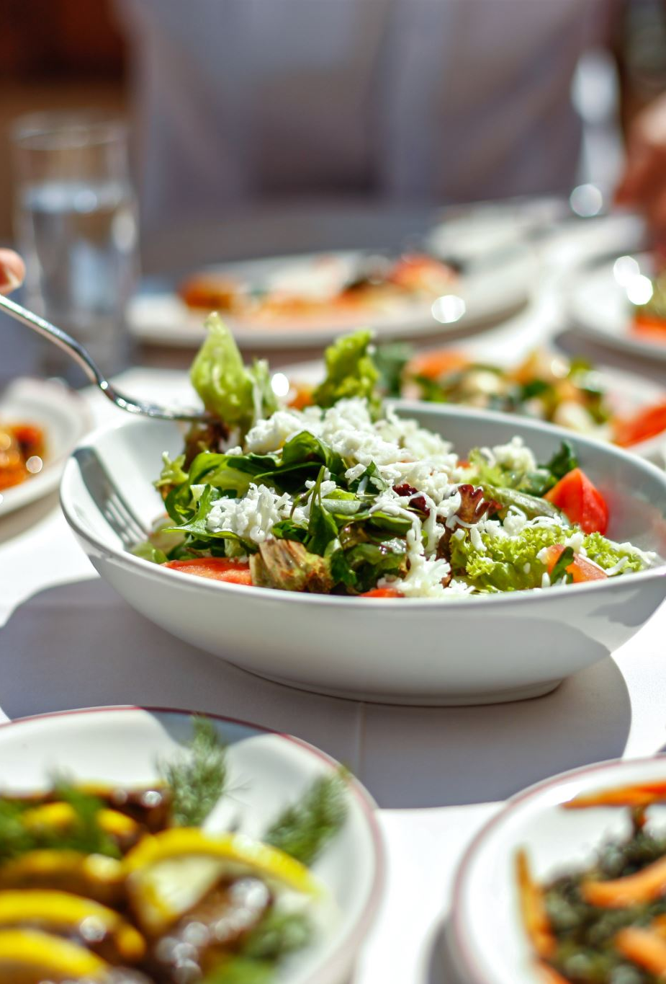
Tangible & Intangible Benefits
For restaurants, the Online Food Ordering System provides a range of tangible benefits. The system allows restaurants to efficiently manage and fulfill orders, which can help to improve their operations and increase their profitability. The system also provides real-time updates to the restaurant, which allows them to quickly and accurately prepare and fulfill orders. Additionally, the system allows restaurants to track their sales data and manage their inventory, which can help to reduce waste and improve their bottom line.
The Online Food Ordering System also provides a number of intangible benefits for restaurants. For example, the system's ratings and reviews feature can help restaurants to improve their reputation and attract new customers. Additionally, the system's real-time communication features can help to create a more efficient and seamless ordering process, which can enhance the overall customer experience and drive repeat business.

Slide 9
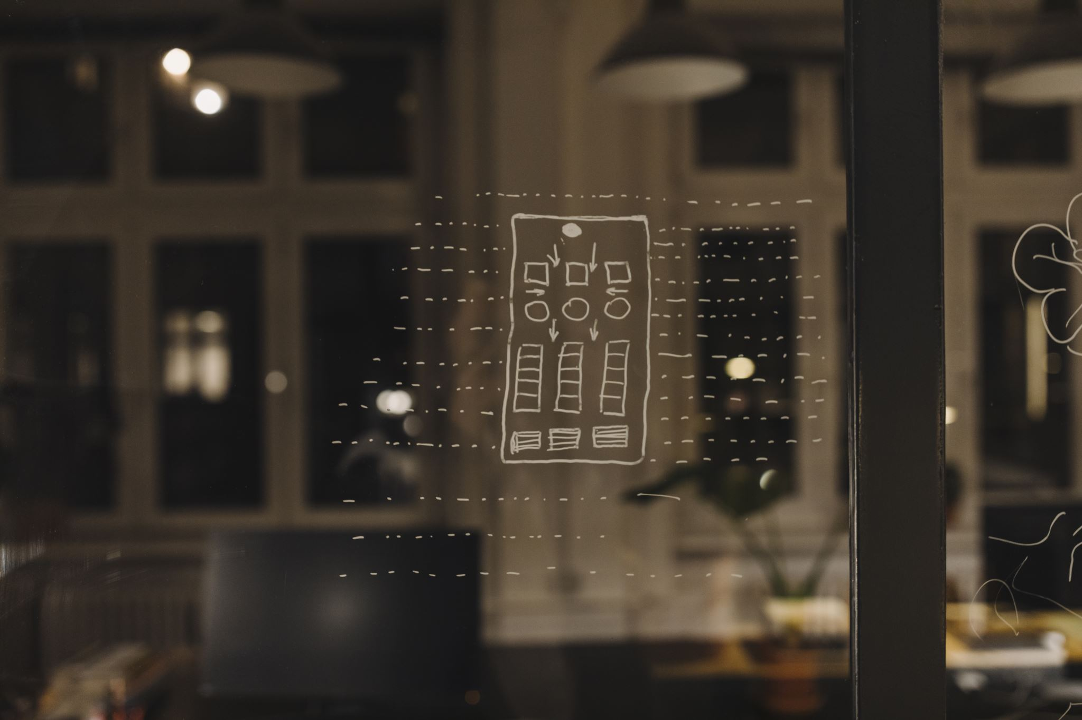
The Project Scope:
The scope of the project includes the development of the food ordering app, which will be built in-house by the project team. This includes the design and implementation of the user interface, the ordering and checkout process, and the real-time communication between the customer and the restaurant. As part of the project, the team will also need to integrate the food ordering app with the restaurant's existing order management system. This integration will involve connecting the app to the order management system, and ensuring that the two systems can exchange data and updates in real-time.

Slide 10
The Project Constraints:
Time constraint: The project is expected to take approximately 6 months to complete, including analysis, design, development, testing, and deployment.
Resource constraint: The project will require a team of web developers, designers, and project managers, as well as the necessary equipment and software to develop and test the food ordering app.
Budget constraint: The project has a fixed budget, and any unexpected costs or changes to the scope of the project may impact the overall cost and profitability of the project.
Technical constraint: The project involves the development of a web-based platform, and may be subject to technical challenges or limitations that could impact the performance, stability, or security of the system.

Slide 11
Constraints-2
Legal and regulatory constraints: The system may be subject to certain legal and regulatory constraints, such as data protection or privacy laws.
Stakeholder constraint: The project involves multiple stakeholders, including the customers, the restaurant, and the project team, and their needs, preferences, and expectations may impact the scope, direction, and success of the project.
User preferences and expectations: The system will also be constrained by the preferences and expectations of the users, both customers and restaurant staff.

Slide 12
Actor Glossary:
Customers: Customers are the primary human actors in the system, interacting with the system through the web interface to browse the menu, place orders, and make payments.
Restaurant: The restaurant and the restaurant staff are the provider of the food and services, and is responsible for managing and fulfilling the orders placed through the system.
Project team: The project team is responsible for designing, developing, and maintaining the online food ordering system.
Delivery drivers: If the system offers food delivery as a service, there may be a team of delivery drivers who are responsible for transporting the food from the restaurant to the customer's location.
Servers and databases: The nonhuman actors in the system include the servers and databases that store and process the data for the system.
Payment processors: The system may also include a payment processing component, which handles the financial transactions between the customer and the restaurant.

